Slide 1
Analysis of Indian Restaurant in Toronto, Canada

Slide 2
We will try to find the Indian Restaurant Business:
If we want to open IR(Indian Restaurant) then we have to analyze various things like:
Location
People’s choice
Already IRs are there or not etc

Slide 3
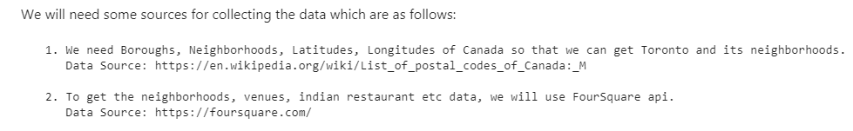
Data Gathering..
To get the data we have reference of Wikipedia and Foursquare API to fetch the venues of the city so that we can come into conclusion.

Slide 4
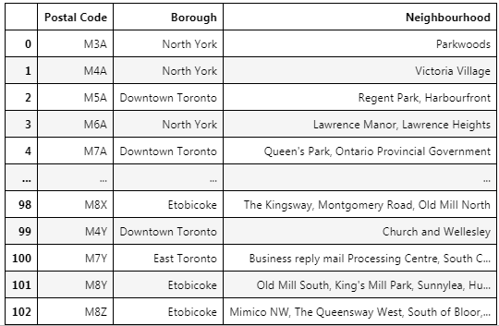
Data Wrangling:
After cleaning the data. Our final data will be like:

Slide 5
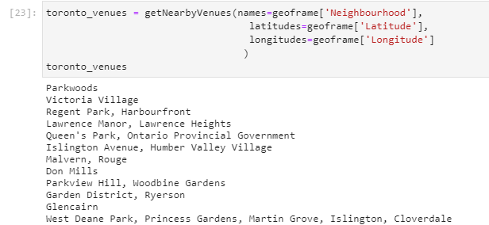
Get NearBy venues of Toronto
To find the IR location, we need a list of all the venues that are already in the Toronto city.

Slide 6
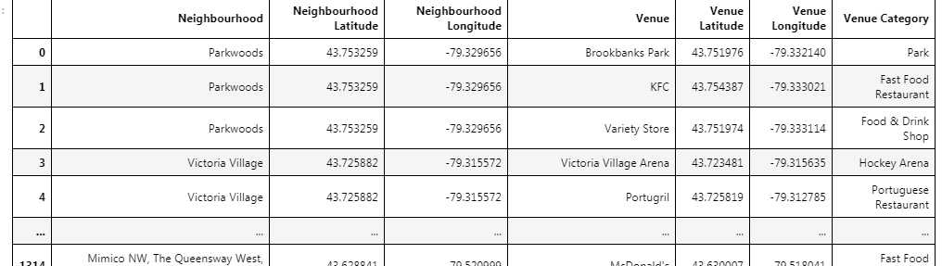
Get NearBy venues of Toronto cont….
List of Neighborhood with Latitutes and longitudes.

Slide 7
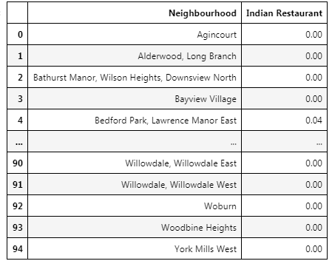
Frequency of Indian Restaurant
After filtering the data, we got our restaurant list. Below one:

Slide 8
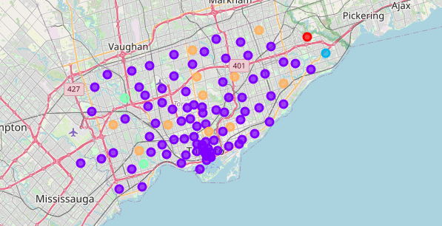
Clusters
We have a visualization of clusters for the locations,

Slide 9
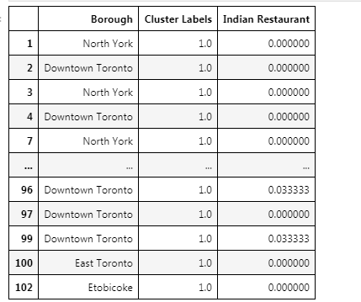
Analysis
As per clusters, we get the restaurant frequency in cluster1 at Downtown toronto. So we can open our restaurant here.

Slide 10
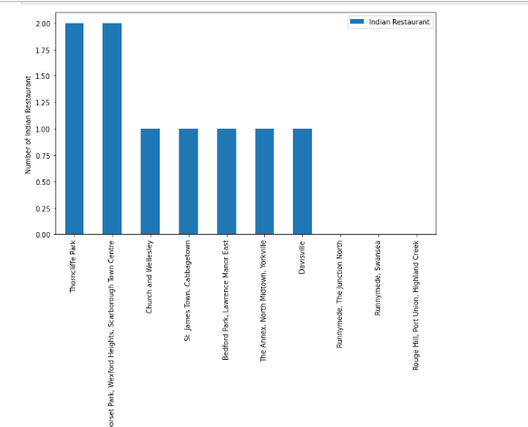
Analysis cont...
To visualization of Indian Restaurant and Neighborhoods. We have below figure:

Slide 11
Result
Scarborough town centre and Thorncliffe part have highest number of Indian Restaurant. In cluster 1 at Downtown toronto, we have frequecy of Indian Restaurant so we can choose this one also. Rest of the clusters, we don't have any restaurant so we won't do any restaurant business here.

